Slide 1
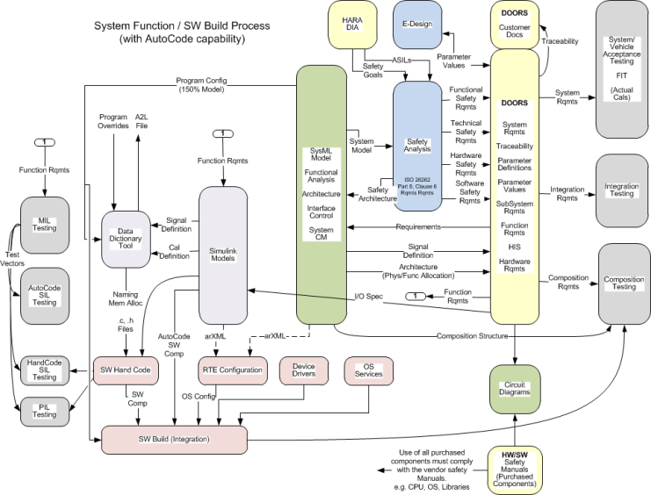
SE09 – Autocoding of System Software Components
Description
Implement capability to go from function definition (FDD) to verified SW component
Create processes and tools to support Autocoding of system functions
Motivation (Score: 4.5)
Development efficiency is primary benefit
Deliverables
FDD documentation standards
Including naming, I/O, data dictionary, etc.
Verification processes (MIL, SIL)
Supporting tools for the above
Autocoded functions
Timing
Method defined and tested by EOY 2014
Team Members/Customers
Core Systems – Kevin Derry, Darryl Greathouse, Price Lefler
Software – Lonnie Newton
Customer – SW Group (Keith Johnson)

Slide 2
SE09 – Autocoding of System Software Components
Status
First FDD (Assist Sum & Limit) working through the process
Challenges
Creation of function requirements to drive MIL testing
Rationalization of current models with SW implementation
Impact of EA4 and AutoSAR 4
Next Steps
Complete Assist Sum & Limit

